Slide 1
Docker With Selenium Grid
Parallel Execution of Tests using Selenium Grid 4 with Docker Compose
16 January 2024
Rohit Sinha/Bikrant Singh

Slide 2
Agenda
What is Docker ?
Docker images, containers and commands
What is selenium Grid ?
Setting up Selenium Grid with Docker
What is docker compose ?
Setting up the tests
Running tests in parallel

Slide 3


Lab49 PPT template
What is Docker ?
Docker is an open platform for developing, shipping, and running applications. It is a containerization tool used to create containers
Docker provides the ability to package and run an application in a loosely isolated environment called a container. The isolation and security lets you run many containers simultaneously on a given host. Containers are lightweight and contain everything needed to run the application, so you don't need to rely on what's installed on the host.

Slide 4
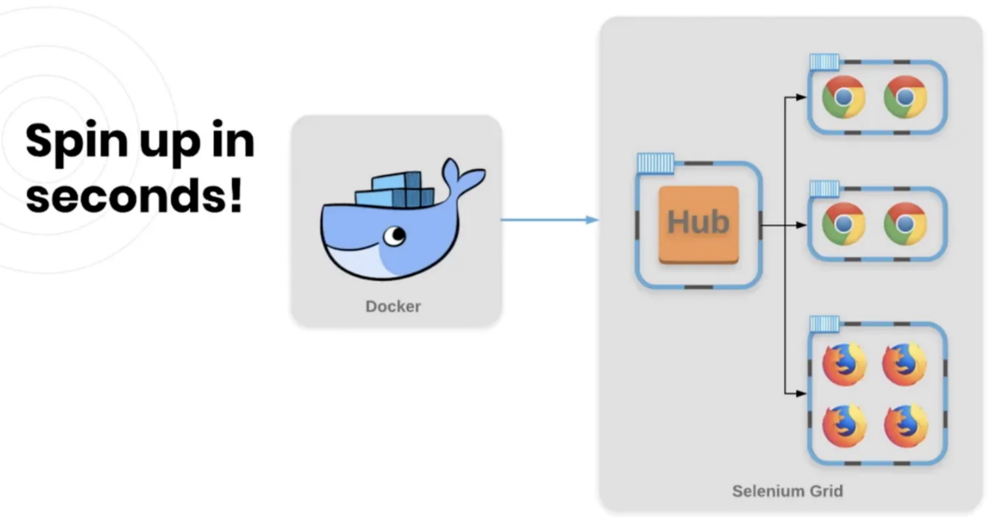
Docker images, containers and commands
IMAGES
An image is a read-only template with instructions for creating a Docker container
You might create your own images, or you might only use those created by others and published in a registry
Docker hub is a docker image repository which will consist of lots of images
https://hub.docker.com/ can be used to download the images
Docker images which will be used to create docker container
docker images – It will list down the images pulled/downloaded
docker pull image name - It will search for given image in the system locally, if not then it will pull that given image from docker hub
For ex. docker pull ubuntu, docker pull selenium/standalone-chrome,
docker pull selenium/hub
CONTAINERS
A container is a runnable instance of an image
You can create, start, stop, move, or delete a container using the Docker API or CLI
For ex. docker run -d -p 4444:4444 --shm-size="2g" selenium/standalone-chrome:4.16.1-20231212
When you run this command, the following happens
If you don’t have the standalone-chrome image locally, Docker pulls it from your configured registry, as though you had run docker pull selenium/standalone-chrome manually

Slide 5

Setting up Selenium Grid with Docker
Useful site : https://github.com/SeleniumHQ/docker-selenium
Install Docker : Begin by installing Docker on your machine. Docker provides a
platform to run the containers that encapsulates your test environment
https://hub.docker.com/r/selenium/hub
Get selenium hub image : docker pull selenium/hub
https://docs.docker.com/get-started/08_using_compose/
Create a Docker Compose file : To define your Selenium Grid setup, create a Docker Compose file. This file specifies the configuration for the Selenium Grid hub and nodes. The hub acts as a central point, while the nodes represents the machines and
browsers where tests will be executed.

Slide 6
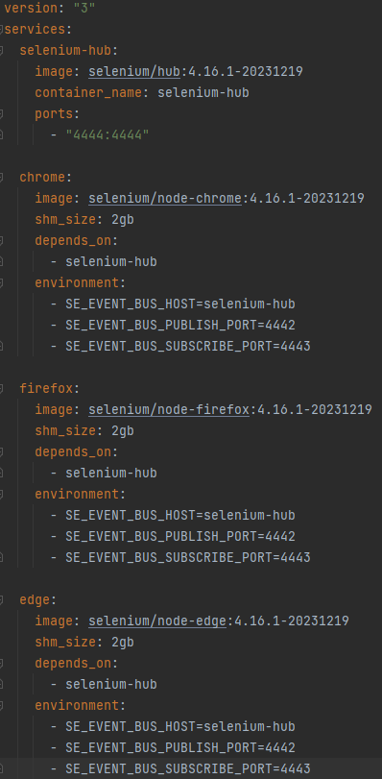
What is docker compose ?
We will be using docker-compose to start the selenium grid as it is easy and maintainable. docker-compose is a tool for defining and running multi-container docker applications. With Compose, we use a Compose file to configure the application’s services. Then, using a single command, we can create and start all the services from configuration. It also has the option to scale the services as and when required. With Compose, we can create a YAML file to define the services and with a single command, can spin everything up or tear it all down.
Let’s break down this YAML file:
version : “3” : This line specifies the version of the Docker Compose file syntax. The version “3” is used in this case
services : This section defines the services(containers) that make up the Selenium Grid infrastructure
Selenium-hub : This section defines the Selenium Grid hub services
image: selenium/hub:4.16.1-20231219 : Specifies the Docker image to use for the hub service. In this case, the selenium/hub image is used, and the 4.16.1-20231219 tag represents the version which we are using now
ports : “4444:4444” : Maps the hosts machine’s port 4444 to the container’s port 4444. This allows external connections to the Selenium Grid hub
Chrome : this section defines the Selenium Grid node service for chrome
Image: selenium/node-chrome: 4.16.1-20231219 : Specifies the Docker image to use for Chrome node service. Here, the selenium/node-chrome image with the 4.16.1-20231219 tag is used
depends_on: - selenium-hub : Indicates that the Chrome node depends on the selenium-hub service. Docker compose ensures that the hub service starts before the Chrome node
environment: -SE_EVENT_BUS_HOST=selenium-hub : Sets the SE_EVENT_BUS_HOST environment variable for Chrome node to point to the selenium-hub service. This allows the node to register with the hub

Slide 7
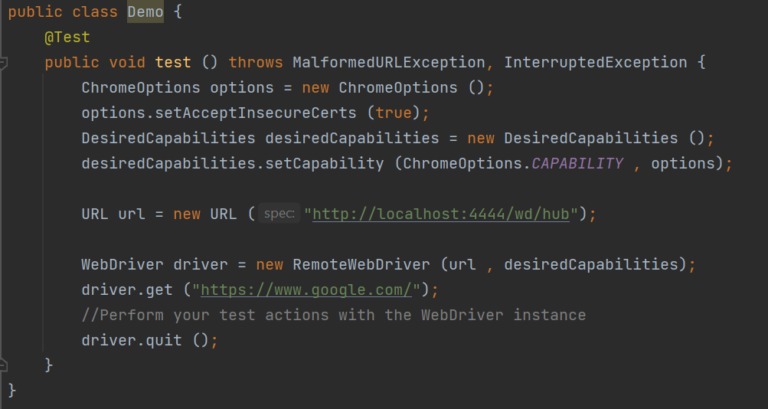
Configuring your test project :

Slide 8
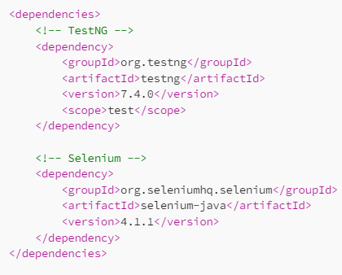
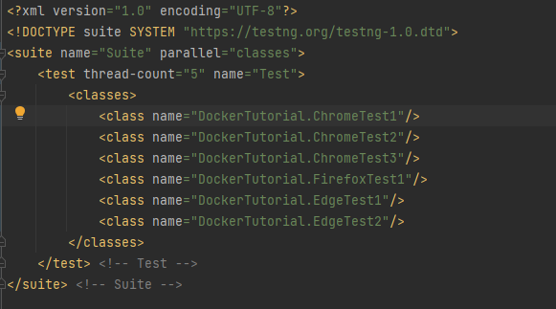
Running tests in parallel:
1.Add Dependencies : In your maven pom.xml file add the dependencies for TestNG and Selenium
2.Configure TestNG XML File : Create a TestNG XML file in the projects root directory. This XML file will define set of classes need to be executed parallelly
3.Create Test Classes : Create test classes that corresponds to the tests defined in the TestNG XML file. Each test class will contain test methods
4.Run the Tests: Finally, you can run the tests using the TestNG test runner.

Slide 9
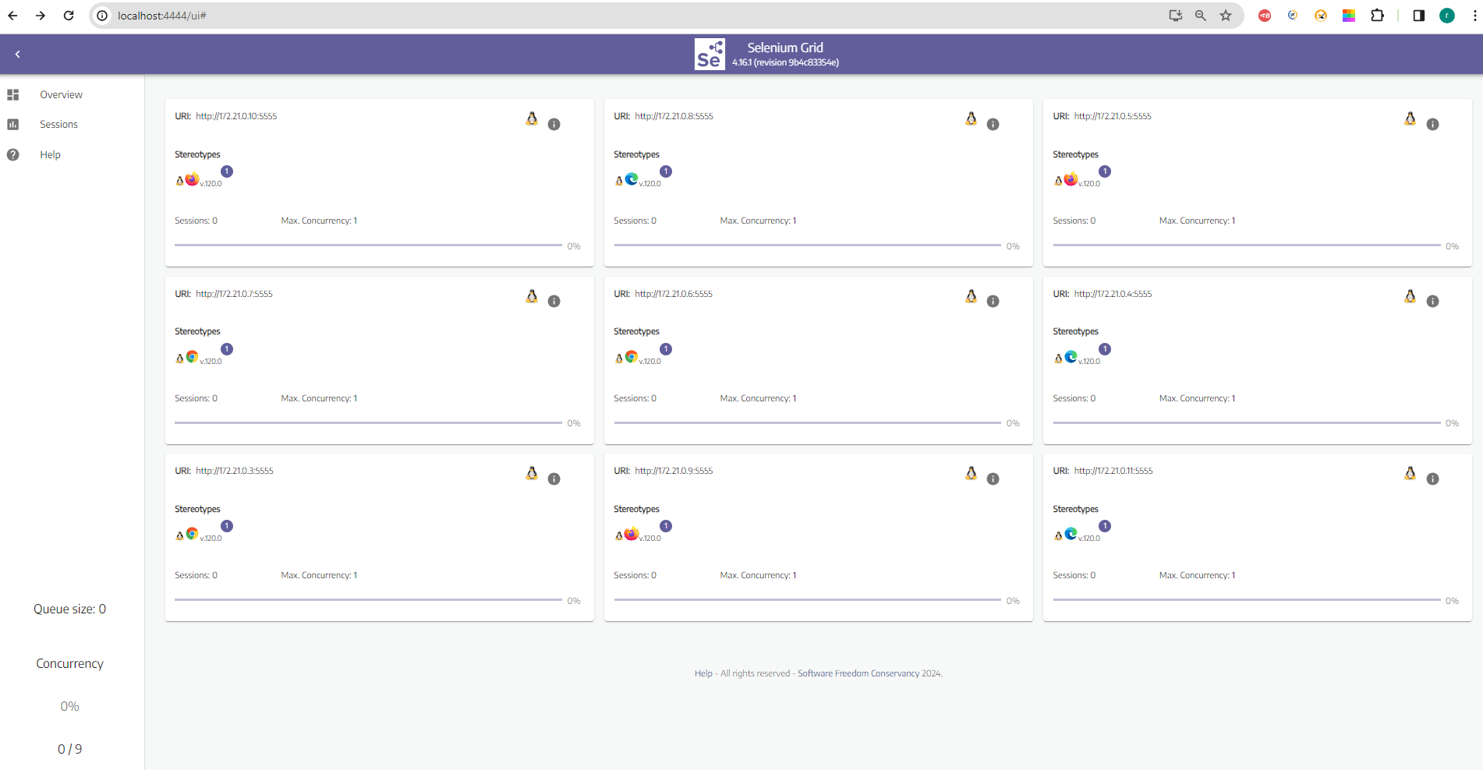
Selenium Grid :

Slide 10
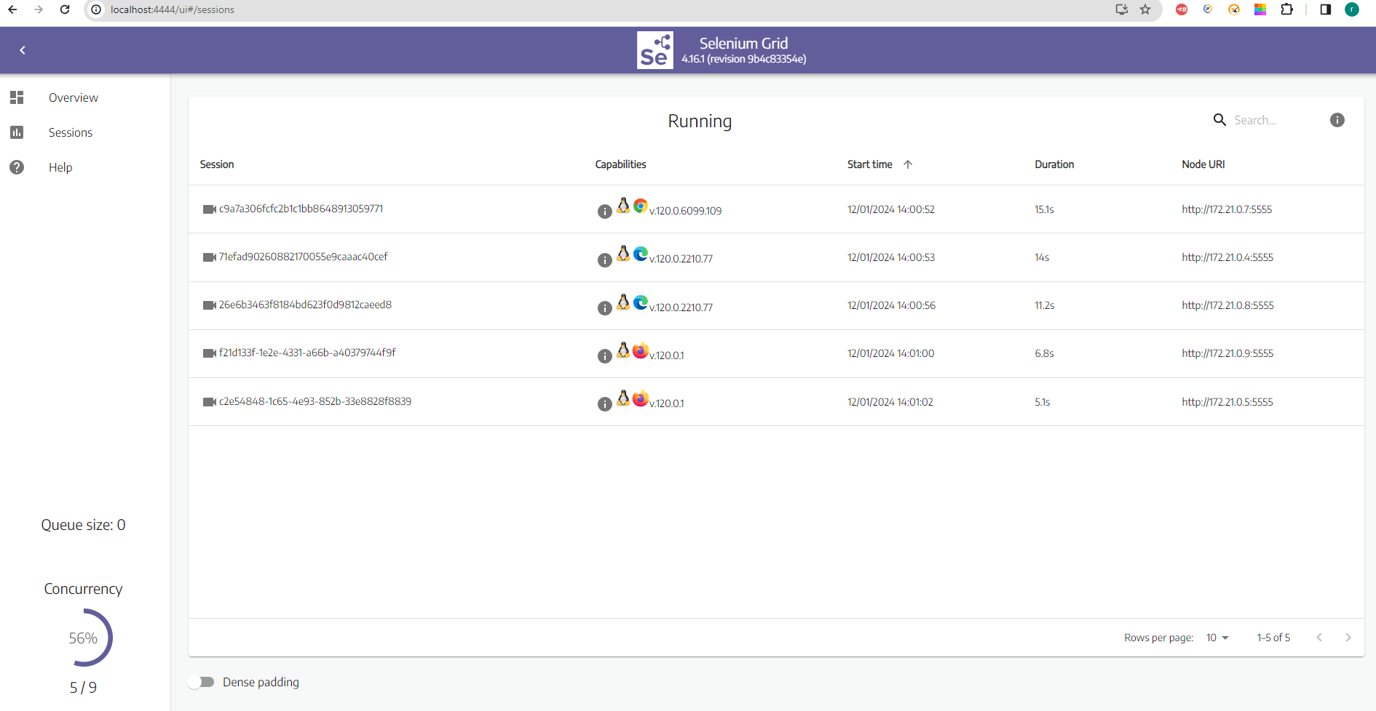
Selenium Grid Parallel Sessions :

Slide 11
Few useful commands :
docker –version – To know the version of docker your system is having
docker images : To show all the images
docker ps : To show all the containers
docker ps –a : To show all the containers including stopped containers
docker start container_id : To start a particular container
docker stop container_id : To stop a particular container
docker rm container_id : To remove the container with the given id
docker system prune –f : To remove all stopped containers
docker system prune –a : To remove all stopped containers +unused images
docker logs containerName : To check container logs
docker run -d -p 4444:4444 --shm-size="2g" selenium/standalone-chrome:4.16.1-20231212
docker-compose up – To start the grid
docker-compose down : To tear down the grid
docker-compose restart : To restart the grid
docker-compose scale chrome=3 : To increase the no. of nodes we can use this command for the browser you want to increase

Slide 12
Helpful Sites :
https://github.com/SeleniumHQ/docker-selenium
https://hub.docker.com/
https://github.com/SeleniumHQ/docker-selenium/blob/trunk/docker-compose-v3.yml
https://docs.docker.com/get-started/overview/
https://www.selenium.dev/documentation/grid/
https://docs.docker.com/get-started/08_using_compose/

